Slide 1

B2B POWER BI DASHBOARD (CHANEL CUSTOMER, SEGMENTATION, AND JOURNEY) AT DIBIMBING.ID (TRAINING PRODUCT)

Slide 2




PROFILE
085704928504
linkedin.com/in/arenggadean
https://github.com/MBAHTAWOONS
Nama | Arengga Dean Prayoga, S.pt
Age | 25 Years (1998)
Occupation | Python User
Education Background
Bachelor degrees of Animal Husbandry (Brawijaya University, 2021)
Data Science Bootcamp (Dibimbing.ID, September 2023)

Slide 3

SLIDE LIST
SUMMARY
PAGE PARTS
FEATURES

Slide 4
SUMMARY

Slide 5
SUMMARY
Business Understanding :
Dibimbing. Id B2B Division is the division that provides customers (companies & schools) who need specialization training and boot camp.
Purpose :
Provide all reports include channel & and segmentation distribution and rank customers from all record customers (companies & schools).
Tools :
- Power BI (as dashboard Creator tools)
- Google Sheets (as master data/ Database)

Slide 6
PAGE UNDERSTANDING
CHANEL & CUSTOMER PAGE :
PAGES SHOWS VISUALS RELATED TO CHANEL TYPE, CUSTOMER STATUS LIKE DONE OR NOT ORDER & TYPE OF TRAINING (FOR CORPORATE OR SCHOOL), AND CUSTOMER TOP RANK.
SEGMENTATION PAGE:
PAGES SHOWS VISUALS RELATED TO SEGMENTATION OF THE CUSTOMER LIKE CITIES, TRAINING TOPIC ORDERED (PRODUCT), CUSTOMER FIELDS, CUSTOMER MAKRO FIELDS.
JOURNEY(RETENTION) PAGE :
PAGES SHOWS VISUALS RELATED TO RETENTION TIME INFORMATION AND CUSTOMER PROCESS TIME FROM APPROACH UNTILL CLOSED (DONE ORDER)

Slide 7
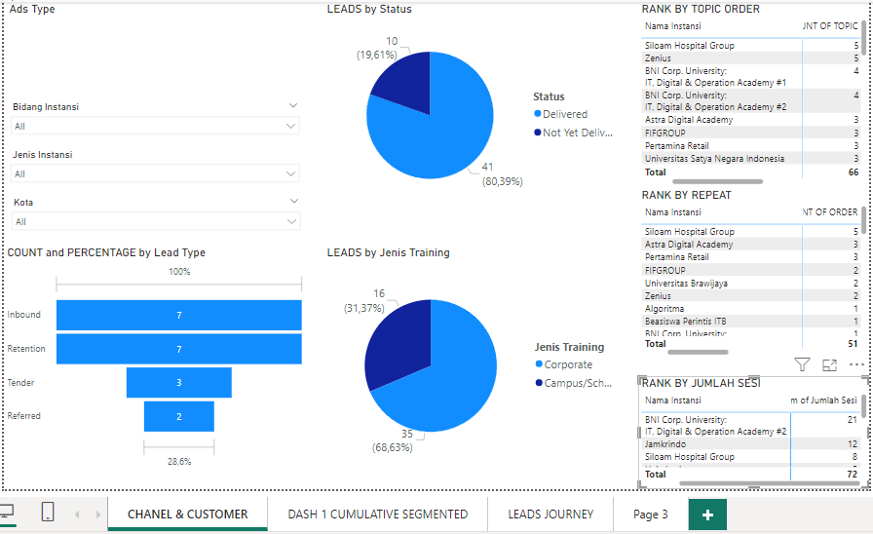
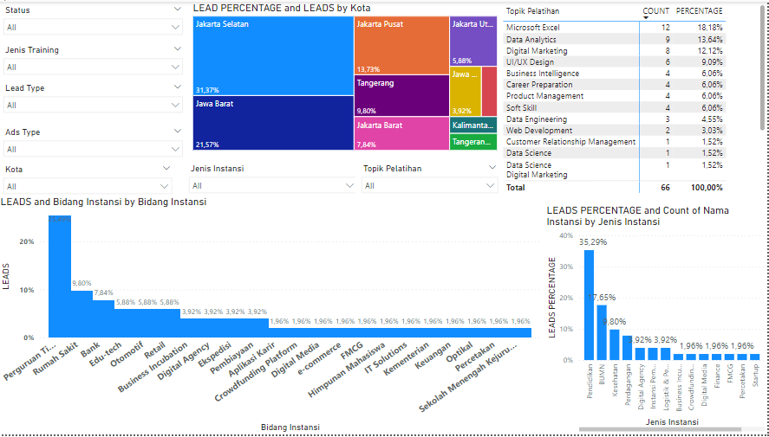
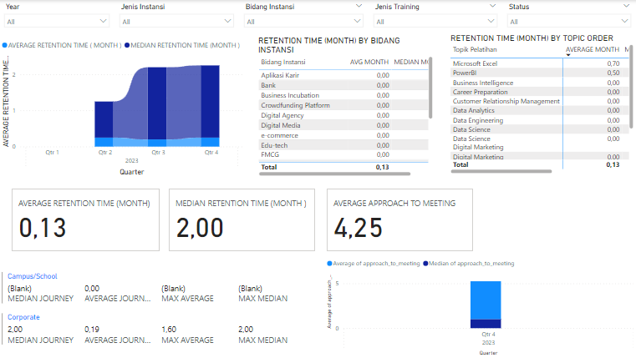
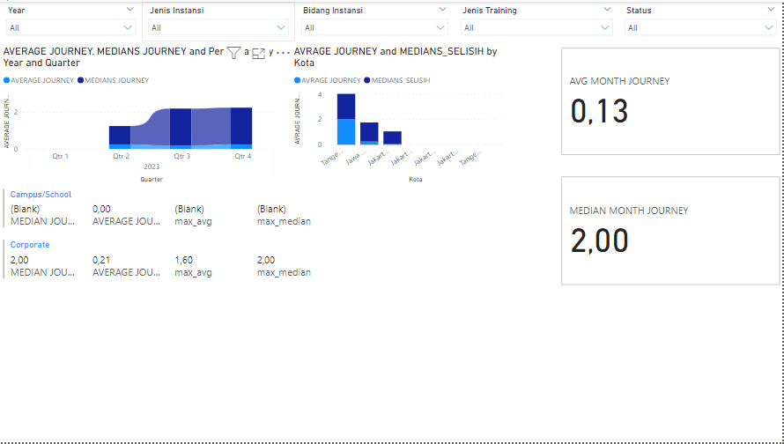
Preview
CHANEL & CUSTOMER PAGE
SEGMENTATION PAGE
JOURNEY PAGE (RETENTION)

Slide 8
PAGE PARTS

Slide 9
Chanel & Customer Page Parts
Filter apply to all visuals (bidang instansi, jenis instansi, kota)
Pie Chart shows count & percentage done order(delivered) or not done order (not delivered yet).
Pie Chart shows count & percentage customer training order (corporate or school)
Funnel Chart shows count and percentage record based on customer channel

Slide 10
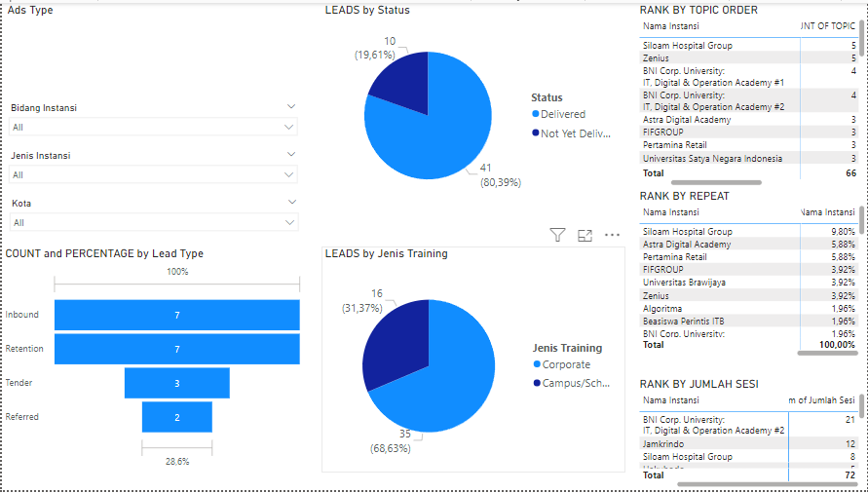
Chanel & Customer Page Parts
Rank customer base on total product topic from all unique customer orders, shows in count & percentage.
Rank a customer based on how many orders the customer has placed with the company. (How much they had repeat orders)
Rank a customer based on the number of sessions performed out of all orders.

Slide 11

Segmentation Page Parts
Filter Apply to all visuals based on segmentation needed city, ads type, agency type, topic of product order, customer type, status delivered or not delivered, training type.
Treemap visual shows city record, with detailed customer count and percentage.
Table matrix that shows customer product topic orders with detail count and percentage.
Barchart visual shows customer agency types such as education or economic agency
Barchart visual shows customer-type explanation fields such as University or Bank, with detail counts and percentage.

Slide 12
Journey Page (Customer Retention) Parts
Filter apply to all visual (year, agency type, agency field, training type, and status delivered or not delivered yet.
Customer retention time (in month) by agency fields, shows in average and median.
Customer retention time (in month) by topic product, shows in average and median.
Retention time (in month) all unique customer, shows in average and median.
Average journey time distance beetween first approach customer untill meeting (agreement)

Slide 13
Journey Page (Customer Retention) Parts
RETENTION TIME (IN MONTH) BY TRAINING TYPE (CAMPUS OR SCHOOL), SHOWS IN AVERAGE, MEDIAN, MIN, AND MAX
JOURNEY DISTANCE TIME BETWEEN APPROACH TO MEETING (AGREEMENT) BY QUARTER IN YEAR. SHOWS IN AVERAGE AND MEDIAN

Slide 14
FEATURES

Slide 15
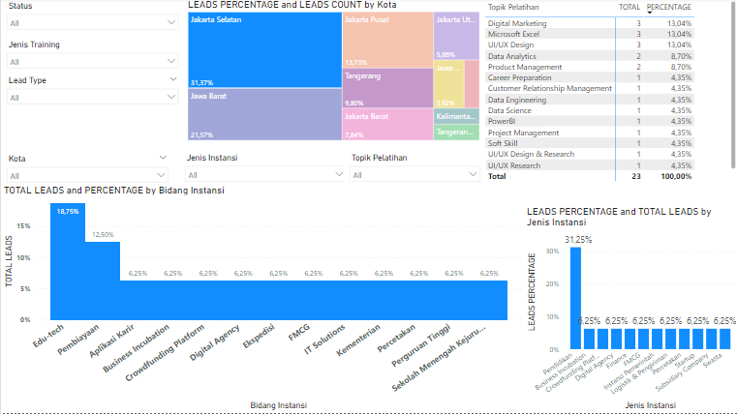
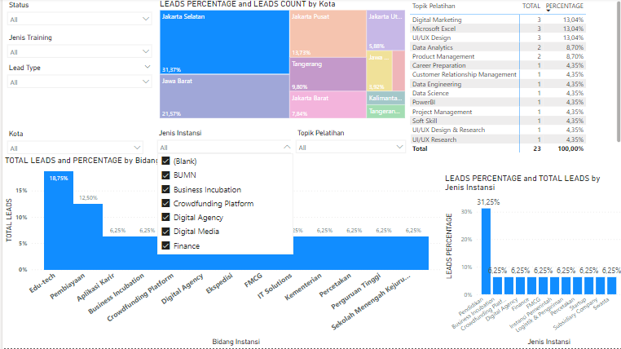
Feature
Press Visuals
You can press part of Visual to Apply filter to page based on visual’s value. This feature already in all visual in all pages
You can Apply filter to page based on slicer’s dropdown value . This feature already in all visual in all pages
Press Slicer

Slide 16
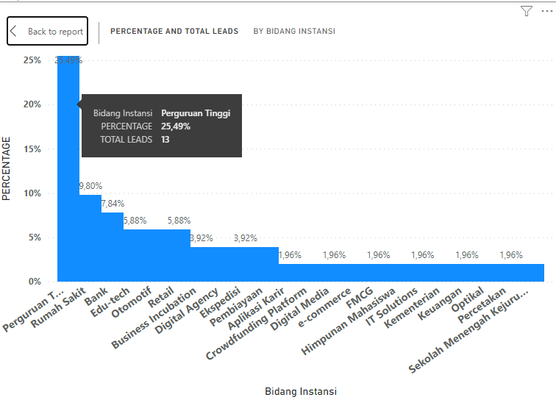
Feature
You can Further the visual to big images that are clear in detail on all visuals and all pages
You can drop the mouse on visual parts to see detailed tips showing percentages and counts on all visuals and all pages
You can see the legends and tooltips label on all visuals and all pages

Slide 17
Thank You
File Download :
https://github.com/MBAHTAWOONS/POWERBI_DASHBOARD_B2B_COMPANIES

